Slide 1
2 KINGS

Slide 2
2 KINGS
Youths ~ KJV, little children
na`ar ~ usually of young men

Slide 3
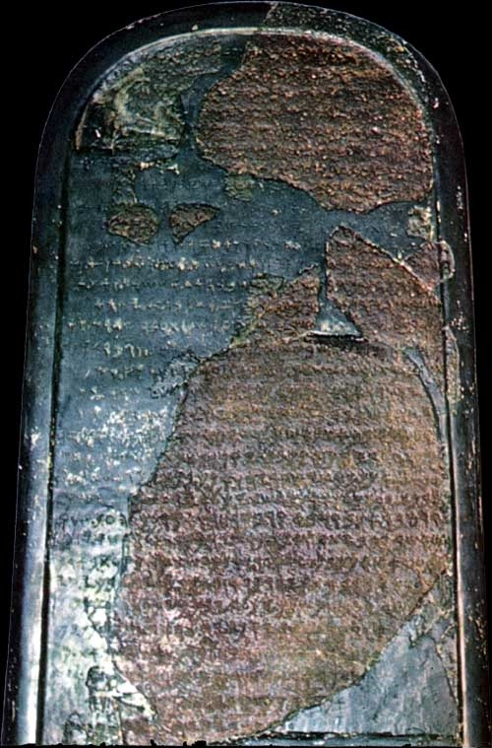
2 KINGS
The Moabite Stone

Slide 4
2 KINGS
Strange miracles of Elisha
Purifying bad water (with salt) (2:19-22
Miraculous multiplication of the widow's oil (4:1-7)
Raising the Shunemite's son by laying on him (4:32-24)
Purifying poisoned pots of stew (4:38-41)
Floating axe-head (6:1-7)

Slide 5
2 KINGS
Judah
Israel
Jehoshaphat
Ahab
Jehoram
Ahaziah
Jehoram
Athaliah
Ahaziah

Slide 6
2 KINGS
Treason! Treason!
Jehosheba
Athaliah
Jehoiada
Joash

Slide 7
2 KINGS
Judah
Israel
Zechariah
Shallum
Uzziah
Menahem
Pekahiah
Pekah

Slide 8
2 KINGS
Jehoshaphat
Hezekiah
Falls to Babylon
Asa
Uzziah
Josiah
Judah
900
800
700
600
Israel
Jeroboam I
Jeroboam II
Falls to Assyria
Jehu
Hoshea
Major Kings of Judah & Israel

